Slide 1
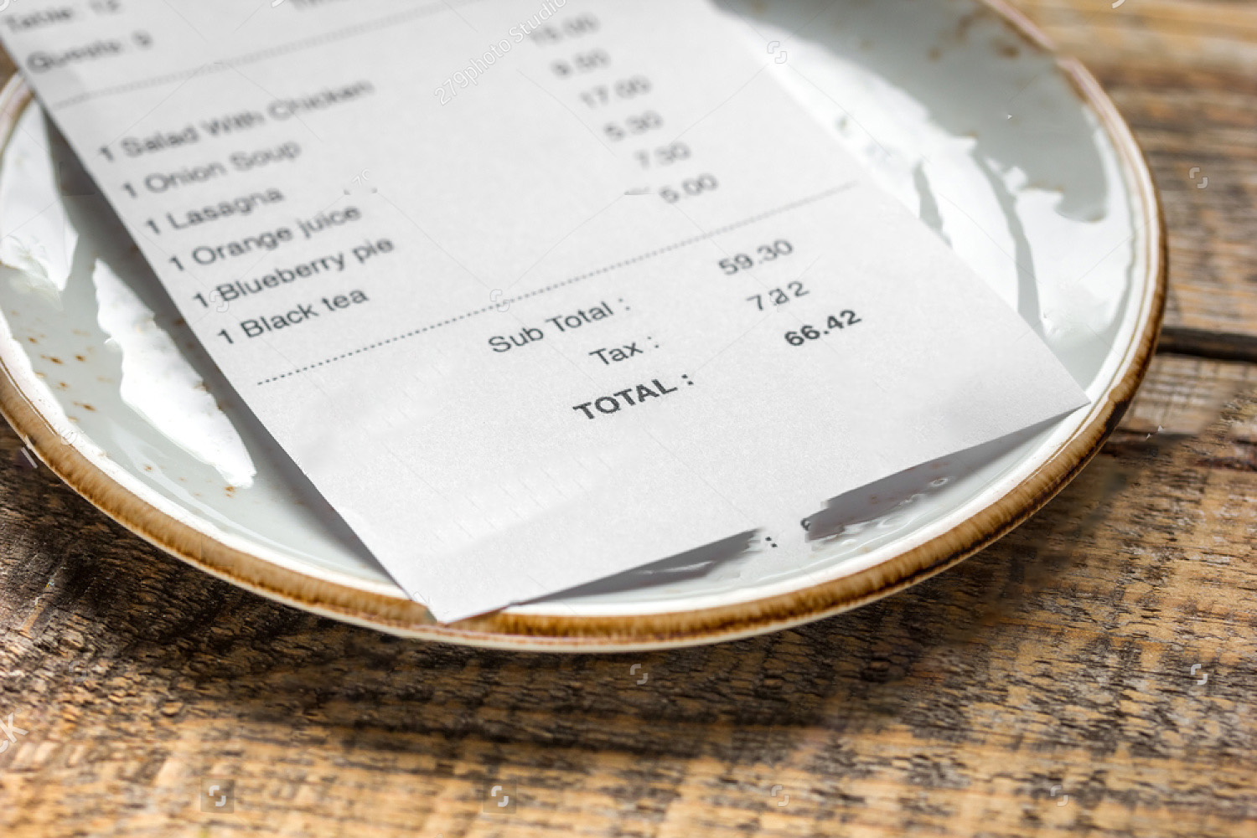
Presentation on
Project 1: Restaurant Billing System
Presented to:
Touhid Ahmed
Lecturer Department of Computer Science & Engineering
Presented by:
Redown Ahmed
2022-1-60-159
Md. Yousuf Hozaifa
2022-1-60-162
Mahin Hasan
2022-1-60-180

Slide 2
Project 1: Restaurant billing system
Restaurant billing system is specially designed for the purpose of adding ordered items and calculating total bill in a restaurant. This system elaborates basic concept for storing and generating ordered item’s detail.
• First, show the list of foods with their associated prices and availability.
• Then, take orders from the customer as much as he/she wants.
• If any food is unavailable, notify the customer.
• Finally, prepare a bill of ordered items. Add 10% service charge and 15% value added tax to the total bill.

Slide 3
Summary
The "Restaurant Billing System" gives us the facility to manage the restaurants' billing systems. This application is helpful for the staff or admin for billing meal orders. Only the administrator has access to this system. Customers can’t access it directly. It also manages customer and sales records, among other things. The owner of a restaurant adds a meal list as much as he needs by using a database. This project has supplied almost all the relevant requirements for the Restaurant Billing System.

Slide 4

Sample
Output

Slide 5
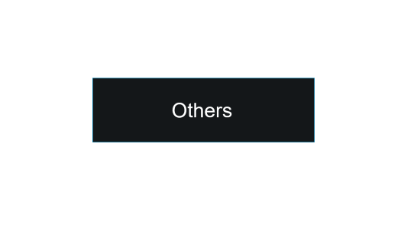
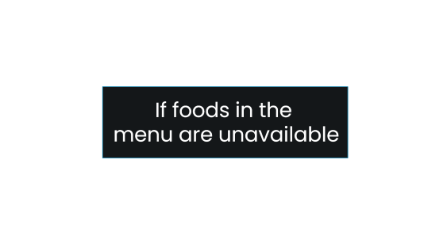
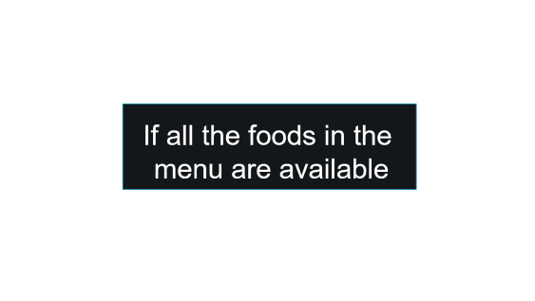
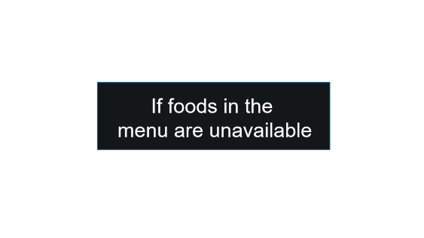

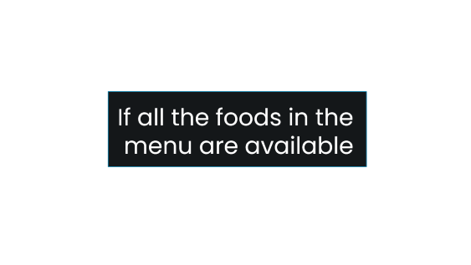

Slide 6
If all the foods in the
menu are available

Slide 7
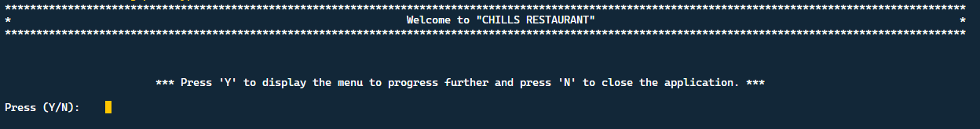

Slide 8
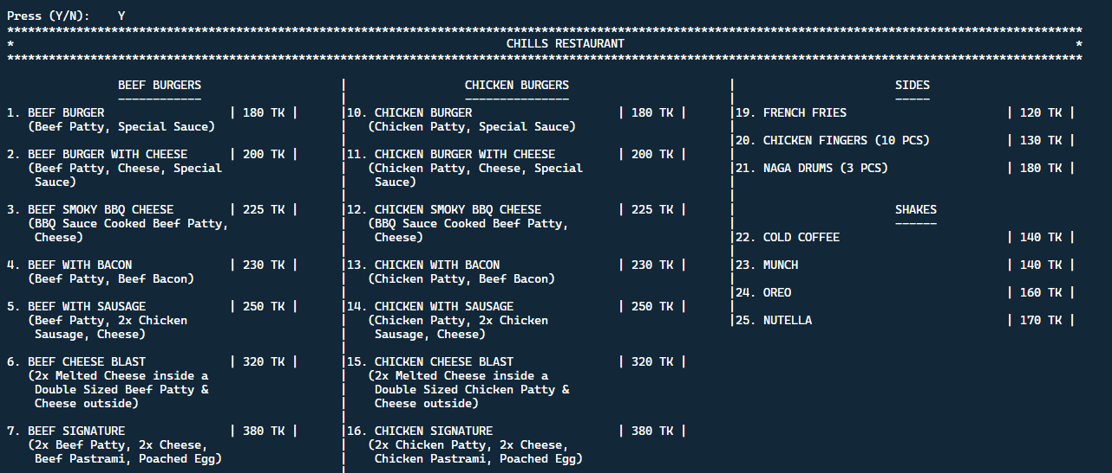

Slide 9
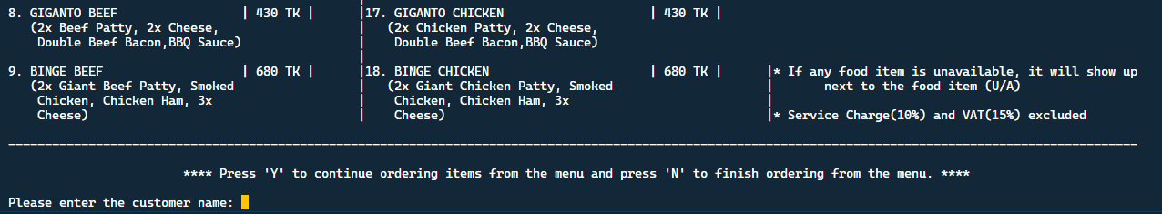

Slide 10


Slide 11
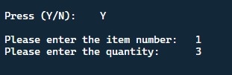

Slide 13
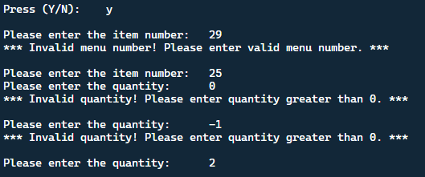

Slide 14
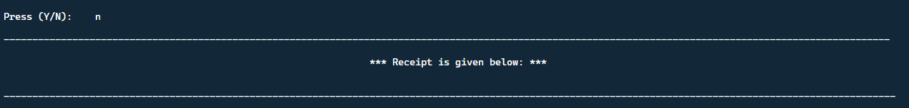
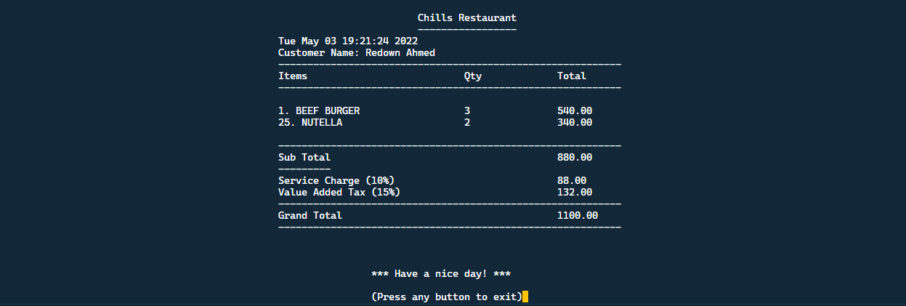

Slide 15
If foods in the
menu are unavailable

Slide 17
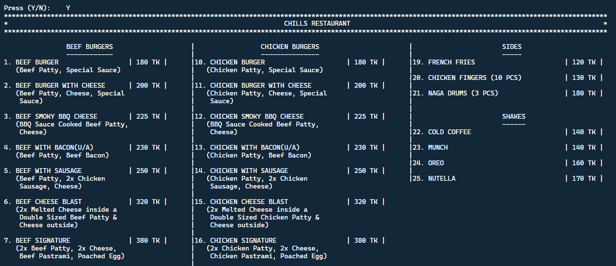

Slide 18
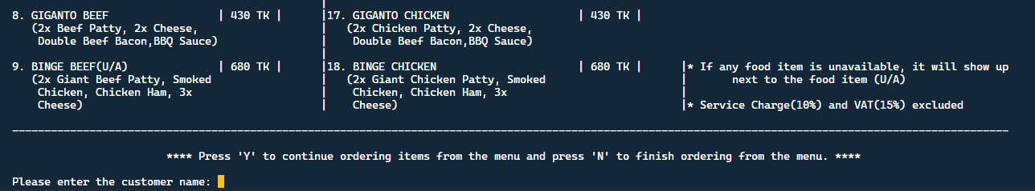

Slide 19
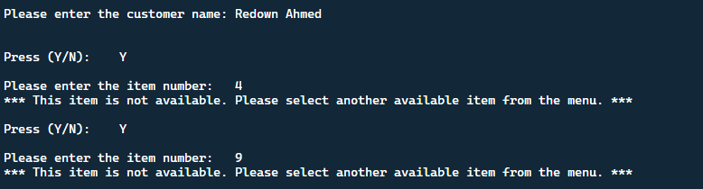

Slide 20
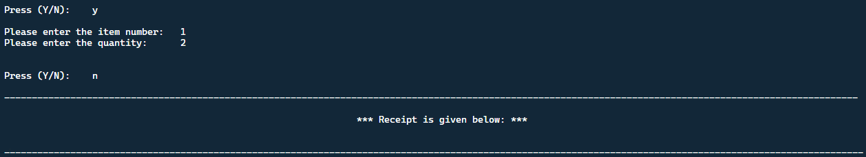

Slide 21
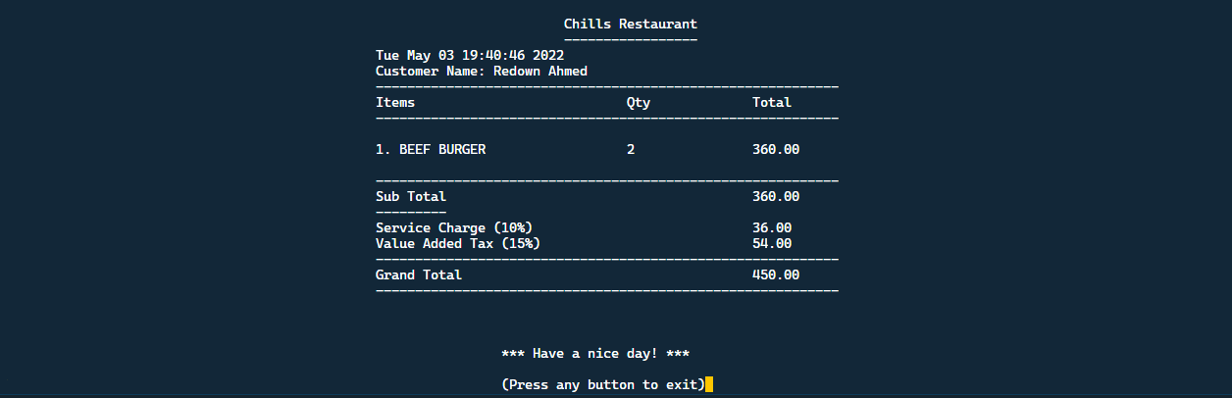

Slide 22
Others

Slide 24
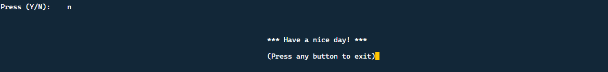

Slide 25
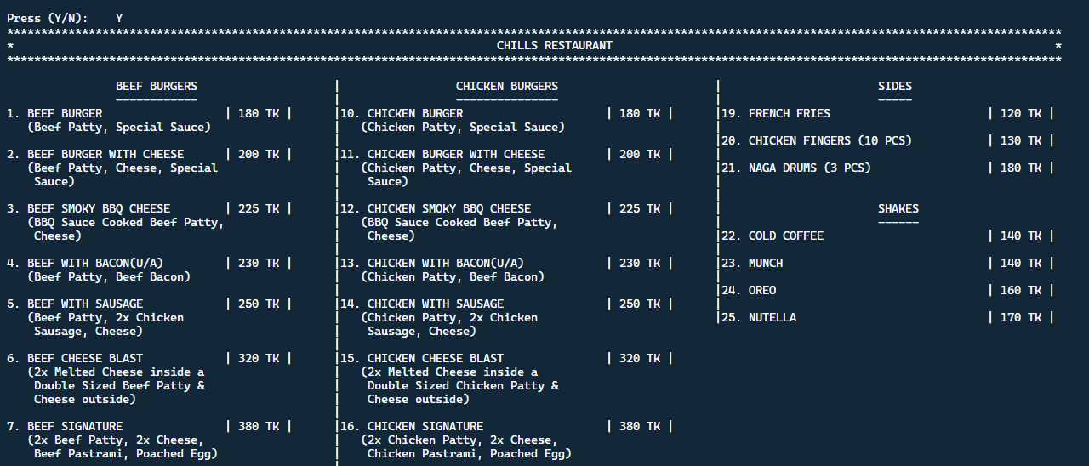

Slide 26
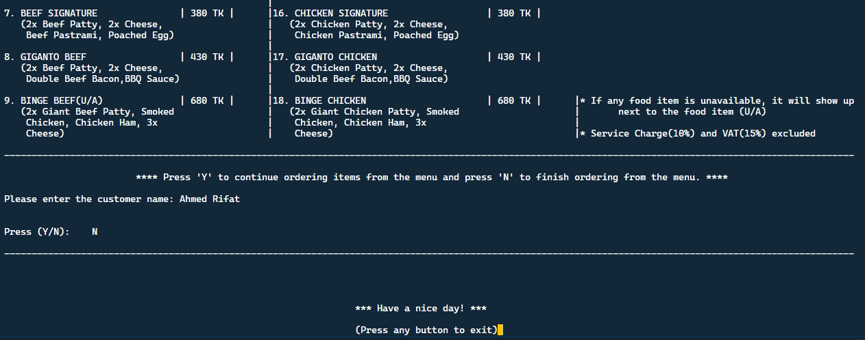

Slide 27

Main Function

Slide 28
#include <stdio.h>
#include <string.h> // used this to perform string library function
#include <ctype.h> // used this to lowercase a character
#include <conio.h> // used this header for getch()
#include <time.h> // used this to generate date and time
struct menu
{
int compare;
char *string_from_menu; // String literal. can't change any element between any index. Stored here menu name.
char string_from_database[200]; // stored here menu name from txt file.
} menu_string[50]; // menu data type array. can store upto 50 stack of items here. But we stored 25 stack of items here.
struct calculation_part
{
double sum, total;
int quantity, input, limit;
char string[200], name[100];
} sum_calculation, sum[50], receipt_string[50], loop, name;

Slide 29
FILE *ptr1,*ptr2; // declared FILE pointer globally
time_t currentTime; // special types of data_type "time_h" for time header, declared currentTime variable
void menu_string_store(); // function prototype
void menu_display(); // for menu display
void calculation(); // for calculation
void receipt(); // generating reciept
void sub_total(); // for total sum without vat and service charge
int main()
{
char input;
printf("*********************************************************************************************************************************************************\n");
printf("*\t\t\t\t\t\t\t\tWelcome to \"CHILLS RESTAURANT\"\t\t\t\t\t\t\t\t*\n");
printf("*********************************************************************************************************************************************************\n");

Slide 30
printf("\n\n\n\t\t\t*** Press 'Y' to display the menu to progress further and press 'N' to close the application. ***\n\n");
start:
printf("Press (Y/N):\t");
scanf("%c", &input);
fflush(stdin);
if (tolower(input) == 'y') // can input either y or Y
{
menu_string_store();
menu_display();
calculation();
if (loop.limit == 0)
{
;
}
else
{
printf("\t\t\t\t\t\t\t\t*** Receipt is given below: ***");
receipt();
}

Slide 31
printf("\n\n\n\t\t\t\t\t\t\t\t*** Have a nice day! ***\n\n\t\t\t\t\t\t\t\t(Press any button to exit)");
}
else if (tolower(input) == 'n') // can input either n or N
{
printf("\n\n\n\t\t\t\t\t\t\t\t*** Have a nice day! ***\n\n\t\t\t\t\t\t\t\t(Press any button to exit)");
}
else
{
printf("*** Invalid keyword! Press 'Y' to display the menu to progress further and press 'N' to close the application. ***\n\n");
goto start; // if user press any keyword except y or n..goto will send the code in start lebel(in 41 no line)
}
getch(); // it will give some time
return 0;
}

Slide 32
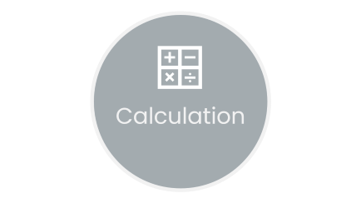


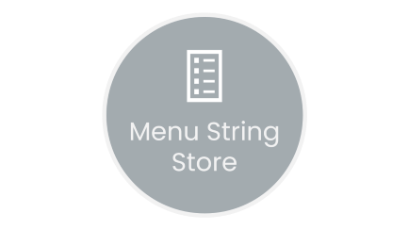
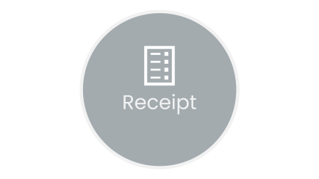

Slide 33

Menu String Store

Slide 34
void menu_string_store()
{ // in this function we stored serially menu items, these are string literals
menu_string[0].string_from_menu = "1. BEEF BURGER";
menu_string[1].string_from_menu = "2. BEEF BURGER WITH CHEESE";
menu_string[2].string_from_menu = "3. BEEF SMOKY BBQ CHEESE";
menu_string[3].string_from_menu = "4. BEEF WITH BACON";
menu_string[4].string_from_menu = "5. BEEF WITH SAUSAGE";
menu_string[5].string_from_menu = "6. BEEF CHEESE BLAST";
menu_string[6].string_from_menu = "7. BEEF SIGNATURE";
menu_string[7].string_from_menu = "8. GIGANTO BEEF";
menu_string[8].string_from_menu = "9. BINGE BEEF";
menu_string[9].string_from_menu = "10. CHICKEN BURGER";
menu_string[10].string_from_menu = "11. CHICKEN BURGER WITH CHEESE";
menu_string[11].string_from_menu = "12. CHICKEN SMOKY BBQ CHEESE";
menu_string[12].string_from_menu = "13. CHICKEN WITH BACON";
menu_string[13].string_from_menu = "14. CHICKEN WITH SAUSAGE";
Menu String Store

Slide 35
menu_string[14].string_from_menu = "15. CHICKEN CHEESE BLAST";
menu_string[15].string_from_menu = "16. CHICKEN SIGNATURE";
menu_string[16].string_from_menu = "17. GIGANTO CHICKEN";
menu_string[17].string_from_menu = "18. BINGE CHICKEN";
menu_string[18].string_from_menu = "19. FRENCH FRIES";
menu_string[19].string_from_menu = "20. CHICKEN FINGERS (10 PCS)";
menu_string[20].string_from_menu = "21. NAGA DRUMS (3 PCS)";
menu_string[21].string_from_menu = "22. COLD COFFEE";
menu_string[22].string_from_menu = "23. MUNCH";
menu_string[23].string_from_menu = "24. OREO";
menu_string[24].string_from_menu = "25. NUTELLA";
}
Menu String Store

Slide 36
Menu Display

Slide 37

void menu_display()
{
int i = 0, j = 0, len;
ptr1 = fopen("C:\\Users\\Rifat\\Desktop\\Project\\Owners Database\\Food Availibility.txt", "r"); // file location (change it in your computer)
char store[200];
while (fgets(menu_string[i].string_from_database, sizeof(menu_string[i].string_from_database), ptr1))
{ // fgets reads strings with a new line and to terminate the new line , used loop and replaces the last element with NULL
len = strlen(menu_string[i].string_from_database);
menu_string[i].string_from_database[len - 1] = 0;
i++;
}
menu_string[i - 1].string_from_database[len - 1] = 'A'; // but fgets doesnt read new line for the last line string of file, so here i assigned the last element as A ,because 25. NUTELLA, here added A in last element
Menu Display

Slide 38
for (j = 0; j < i; j++)
{ // compares the string of menu and string from database and stored in menu_string[j].compare
menu_string[j].compare = strcmp(menu_string[j].string_from_menu, menu_string[j].string_from_database);
}
printf("***********************************************************************************************************************************************************\n");
printf("*\t\t\t\t\t\t\t\t\tCHILLS RESTAURANT\t\t\t\t\t\t\t\t *\n");
printf("***********************************************************************************************************************************************************\n");
printf("\n");
printf("\t\tBEEF BURGERS\t\t\t");
printf("|\t\t CHICKEN BURGERS\t\t\t|\t\t\tSIDES\n");
printf("\t\t------------\t\t\t|\t\t ---------------\t\t\t|\t\t\t-----\n");
Menu Display

Slide 39
// for display purposes
if (menu_string[0].compare == 0)
printf("%s\t\t\t| 180 TK |", menu_string[0].string_from_menu);
else
printf("%s(U/A)\t\t| 180 TK |", menu_string[0].string_from_menu);
printf("\t");
if (menu_string[9].compare == 0)
printf("|%s\t\t\t| 180 TK |", menu_string[9].string_from_menu);
else
printf("|%s(U/A)\t\t| 180 TK |", menu_string[9].string_from_menu);
printf("\t");
Menu Display

Slide 40

Calculation

Slide 41
void calculation()
{
char input; // local variable,takes only single character
printf("-----------------------------------------------------------------------------------------------------------------------------------------------------------\n\n");
printf("\t\t\t**** Press 'Y' to continue ordering items from the menu and press 'N' to finish ordering from the menu. ****\n\n");
printf("Please enter the customer name:\t");
fflush(stdin); // if there is any newline character comes through this library function converts this '\n' to NULL to avoid buffer
gets(name.name); // customer name
printf("\n\n");
Calculation

Slide 42
switch (sum_calculation.input)
{
case 1:
if (menu_string[0].compare == 0) {
quantity_again1:
printf("Please enter the quantity:\t");
fflush(stdin);
scanf("%d", &sum[loop.limit].quantity);
if (sum[loop.limit].quantity > 0)
{
fflush(stdin);
sum[loop.limit].sum = 180.0 * sum[loop.limit].quantity; strcpy(receipt_string[loop.limit].string, menu_string[0].string_from_menu); // copied our string menu no 1 to receipt_string[50].string[200],see in void menu_string_store() function
printf("\n\n");
break;
}
Calculation

Slide 43
else
{
printf("*** Invalid quantity! Please enter quantity greater than 0. ***\n\n");
goto quantity_again1; // if not greater than 0, code will jump here from 155 no line and run its code again
}
}
else
{
printf("*** This item is not available. Please select another available item from the menu. ***\n\n");
goto again; // if the menu is unavailable code will jump to line no 139
}
Calculation

Slide 44
[ case 2 to 25 -→ Same as case 1 ]
default:
printf("*** Invalid menu number! Please enter valid menu number. ***\n\n");
goto again_menu;
}
}
else if (tolower(input) == 'n')
{
printf("-----------------------------------------------------------------------------------------------------------------------------------------------------------\n\n");
break;
}
else
{
printf("*** Invalid keyword! Please press 'Y' to continue ordering items from the menu and press 'N' to finish ordering from the menu. ***\n\n");
fflush(stdin);
}
}
}
Calculation

Slide 45

Sub-Total

Slide 46
void sub_total()
{
for (int i = 0; i < loop.limit; i++)
{
sum_calculation.total += sum[i].sum; // simply summation of all sum[50].sum....see calculation()
}
}
Sub-Total

Slide 47

Receipt

Slide 48
void receipt()
{
time(&currentTime); // passing address through time library function of time.h
int i;
double service_charge, vat;
printf("\n\n\n------------------------------------------------------------------------------------------------------------------------------------------------------------\n\n");
printf("\t\t\t\t\t\t\t\t\tChills Restaurant\n");
printf("\t\t\t\t\t\t\t\t\t-----------------\n");
printf("\t\t\t\t\t\t%s", ctime(&currentTime));// ctime library function prints current time and date in a string with a newline.
printf("\t\t\t\t\t\tCustomer Name: %s\n", name.name);
printf("\t\t\t\t\t\t-----------------------------------------------------------\n");
printf("\t\t\t\t\t\tItems\t\t\t\tQty\t\tTotal\n");
printf("\t\t\t\t\t\t-----------------------------------------------------------\n\n");
Rec
eipt

Slide 49
for (i = 0; i < loop.limit; i++)
{
if (strlen(receipt_string[i].string) <= 15)
{
if (sum[i].sum == 0)
continue;
else
printf("\t\t\t\t\t\t%s\t\t\t%d\t\t%.2lf\n", receipt_string[i].string, sum[i].quantity, sum[i].sum);
}
else if (strlen(receipt_string[i].string) > 15 && strlen(receipt_string[i].string) <= 22)
{
if (sum[i].sum == 0)
continue;
else
printf("\t\t\t\t\t\t%s\t\t%d\t\t%.2lf\n", receipt_string[i].string, sum[i].quantity, sum[i].sum);
}
Rec
eipt

Slide 50
else
{
if (sum[i].sum == 0)
continue;
else
printf("\t\t\t\t\t\t%s\t%d\t\t%.2lf\n", receipt_string[i].string, sum[i].quantity, sum[i].sum);
}
}
printf("\n\t\t\t\t\t\t-----------------------------------------------------------\n");
printf("\t\t\t\t\t\tSub Total\t\t\t\t\t");
sub_total();
printf("%.2lf\n", sum_calculation.total);
printf("\t\t\t\t\t\t---------\n");
Rec
eipt

Slide 51
service_charge = .1 * sum_calculation.total;
printf("\t\t\t\t\t\tService Charge (10%)\t\t\t\t%.2lf\n", service_charge);
vat = .15 * sum_calculation.total;
printf("\t\t\t\t\t\tValue Added Tax (15%)\t\t\t\t%.2lf\n", vat);
printf("\t\t\t\t\t\t-----------------------------------------------------------\n");
printf("\t\t\t\t\t\tGrand Total\t\t\t\t\t%.2lf\n", sum_calculation.total + service_charge + vat);
printf("\t\t\t\t\t\t-----------------------------------------------------------\n");
Rec
eipt

Slide 52
//storing all receipts in file which is for the owners
ptr2 = fopen("C:\\Users\\Rifat\\Desktop\\Project\\Owners Database\\Reciept List.txt", "a");
fprintf(ptr2,"\n\n\n--------------------------------------------------------------------------------------------------------\n");
fprintf(ptr2,"\t\t\tChills Restaurant\n");
fprintf(ptr2,"\t\t\t-----------------\n");
fprintf(ptr2,"%s", ctime(&currentTime));// ctime library function prints current time and date in a string with a newline.
fprintf(ptr2,"Customer Name: %s\n", name.name);
fprintf(ptr2,"------------------------------------------------------------------------------\n");
fprintf(ptr2,"Items\t\t\t\tQty\t\tTotal\n");
fprintf(ptr2,"------------------------------------------------------------------------------\n\n");
Rec
eipt

Slide 53
for (i = 0; i < loop.limit; i++)
{
if (strlen(receipt_string[i].string) <= 15)
{
if (sum[i].sum == 0)
continue;
else
fprintf(ptr2,"%s\t\t\t%d\t\t%.2lf\n", receipt_string[i].string, sum[i].quantity, sum[i].sum);
}
else if (strlen(receipt_string[i].string) > 15 && strlen(receipt_string[i].string) <= 22)
{
if (sum[i].sum == 0)
continue;
else
fprintf(ptr2,"%s\t\t%d\t\t%.2lf\n", receipt_string[i].string, sum[i].quantity, sum[i].sum);
}
Rec
eipt

Slide 54
else
{
if (sum[i].sum == 0)
continue;
else
fprintf(ptr2,"%s\t%d\t\t%.2lf\n", receipt_string[i].string, sum[i].quantity, sum[i].sum);
}
}
fprintf(ptr2,"\n---------------------------------------------------------------------------\n");
fprintf(ptr2,"Sub Total\t\t\t\t\t");
fprintf(ptr2,"%.2lf\n", sum_calculation.total);
fprintf(ptr2,"---------\n");
fprintf(ptr2,"Service Charge (10%)\t\t\t\t%.2lf\n", service_charge);
fprintf(ptr2,"Value Added Tax (15%)\t\t\t\t%.2lf\n", vat);
fprintf(ptr2,"------------------------------------------------------------------------------\n");
fprintf(ptr2,"Grand Total\t\t\t\t\t%.2lf\n", sum_calculation.total + service_charge + vat);
fprintf(ptr2,"------------------------------------------------------------------------------\n");
fclose(ptr2); }
Rec
eipt

Slide 55
--------------------------------------------------------------------------------------------------------
Chills Restaurant
-----------------
Tue May 03 19:21:24 2022
Customer Name: Redown Ahmed
------------------------------------------------------------------------------
Items Qty Total
------------------------------------------------------------------------------
1. BEEF BURGER 3 540.00
25. NUTELLA 2 340.00
---------------------------------------------------------------------------
Sub Total 880.00
---------
Service Charge (10%) 88.00
Value Added Tax (15%) 132.00
------------------------------------------------------------------------------
Grand Total 1100.00
------------------------------------------------------------------------------
Rec
eipt

Slide 56

Food Availibility
.txt

Slide 57
1. BEEF BURGER
2. BEEF BURGER WITH CHEESE
3. BEEF SMOKY BBQ CHEESE
4. BEEF WITH BACON
5. BEEF WITH SAUSAGE
6. BEEF CHEESE BLAST
7. BEEF SIGNATURE
8. GIGANTO BEEF
9. BINGE BEEF
10. CHICKEN BURGER
11. CHICKEN BURGER WITH CHEESE
12. CHICKEN SMOKY BBQ CHEESE
13. CHICKEN WITH BACON
14. CHICKEN WITH SAUSAGE
15. CHICKEN CHEESE BLAST
16. CHICKEN SIGNATURE
17. GIGANTO CHICKEN
18. BINGE CHICKEN
19. FRENCH FRIES
20. CHICKEN FINGERS (10 PCS)
21. NAGA DRUMS (3 PCS)
22. COLD COFFEE
23. MUNCH
24. OREO
25. NUTELLA
Food Availi
Bility.
txt

Slide 58

Question Answer

Slide 59
Thank You

